Slide 1
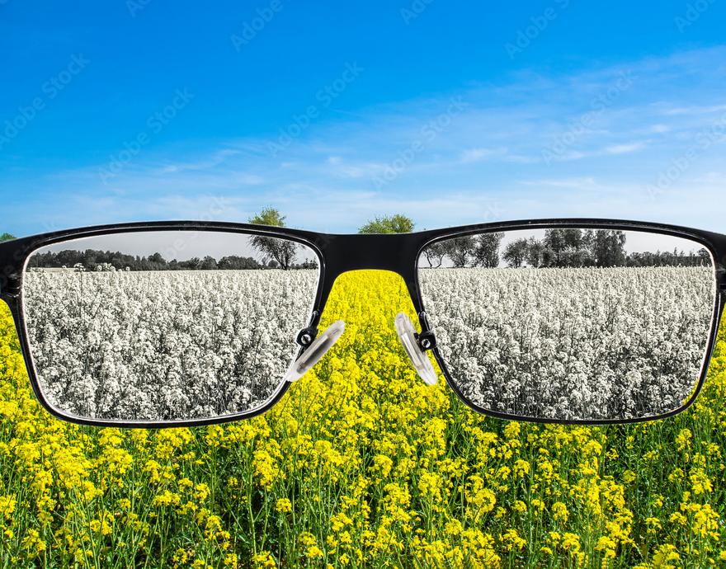
Enhancing Images for Color Vision Deficiency (CVD) with Deep Learning
Taneem Ahmed (2013102042)
Siddhartha Sankar Saha (2011567042)
Mahbub Morshed Rifat (2011415042)

Slide 2
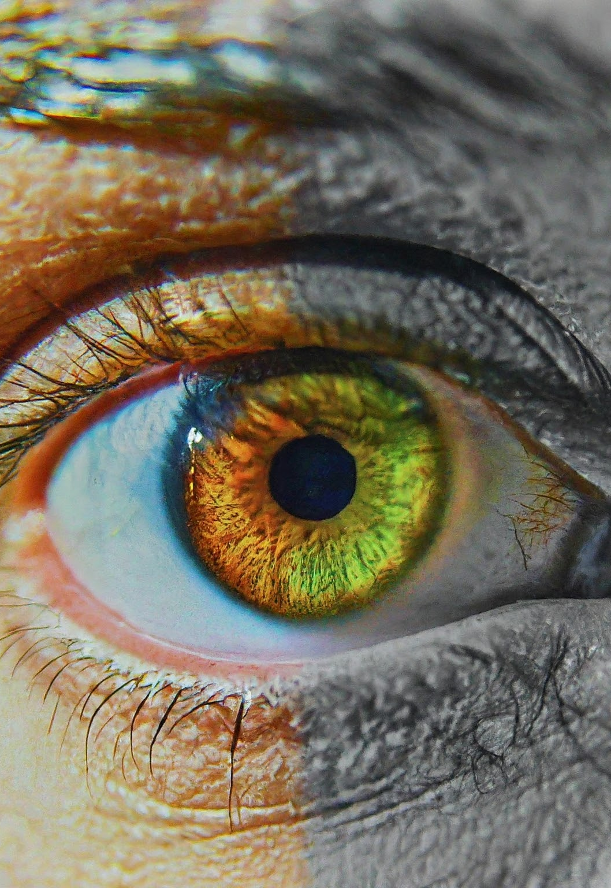
What is the project?
Daltonization is a technique that adjusts image colors to help people with color vision deficiency(CVD). This research aims to demonstrate AI methods like deep learning to make images more tangible to people with color vision deficiency. The goal of employing models like the neural network CNN-based Autoencoders model on daltonization is to create personalized image representations that cater to their specific visual needs. Our research paves the way for a future where technology bridges the gap in color perception.

Slide 3
Analysis of the Design
The design presents an image processing pipeline to create color-blind-friendly images. It sources landscape pictures from Kaggle and then makes a diverse custom dataset by applying a Daltonization algorithm to it. Images are preprocessed by resizing, normalization, and conversion to tensor.
A CNN-based autoencoder is trained on original images with daltonized color blindness (Protanopia, Deuteranopia, Tritanopia) images to learn efficient representations and minimize the differences between reconstructions and daltonized versions.
The model is validated against a held-out set, with potential iteration if results are unsatisfactory. The final outputs are transformed images that enhance accessibility for individuals with various types of color vision deficiency and also enable non-colorblind users to simulate the experience, too.

Slide 4
Usability and Manufacturability
Usability
Manufacturability
Ease of Use: Minimal technical knowledge to operate. To specify color blindness types and receive palette suggestions, ensuring a seamless user experience encourages the adoption and usage of the tool.
Accuracy of Palettes: The generated color palettes enhance the ability to distinguish colors in the uploaded image for CVD people. Users rely on the tool to provide accurate recommendations that align with their color vision deficiencies.
Personalization: Enhancing user engagement and satisfaction by providing tailored solutions that cater to individual needs and preferences.
Versatile Deployment Options: Ensuring web application, mobile app, or API.
Accessibility: Ensuring everyone can access through the user interface.
User-Driven Improvement: Users have the option to share their thoughts and suggestions on generated palettes
Tailored Experience: Options to adjust palette characteristics, such as boldness or saturation, to specific preferences and visual requirements.
Educational Resources: Comprehensive resources on CVD and the benefits of using accessible color palettes empower users with knowledge by stimulating inclusive design practices and raising awareness.

Slide 5
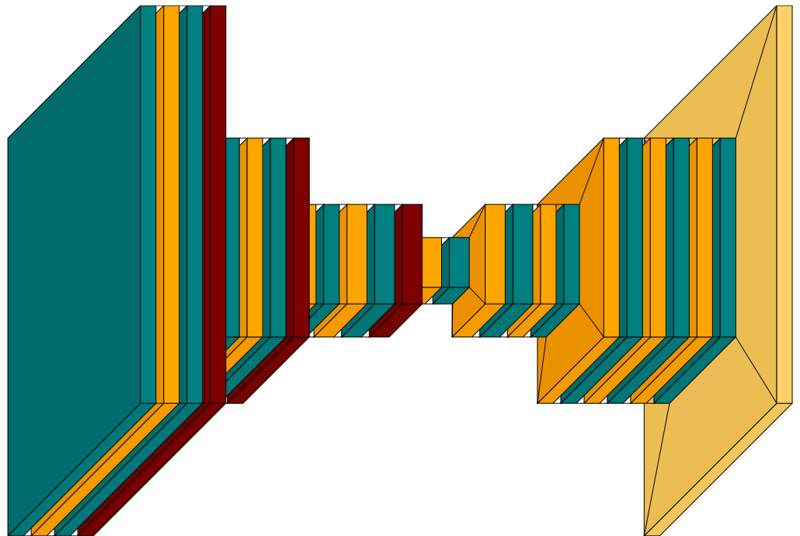
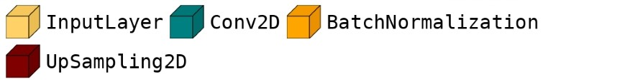
Implementation
The core of our image processing pipeline is a meticulously crafted CNN-based autoencoder model. This neural network architecture is tasked with learning intricate mappings between the original and color-blind image pairs.
The encoder module within the autoencoder compresses input images into a compact latent representation, capturing the most noticeable features while discarding irrelevant information.
Armed with this latent representation, the decoder module strives to reconstruct the original image, thus effectively learning to translate between the standard and color vision-deficient versions.
The decoder is further augmented with skip connections, a technique known to enhance image reconstruction quality by preserving intricate details.

Slide 6
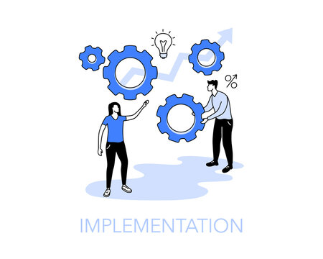
Implementation
The training process involves an iterative loop where batches of images are fed to the autoencoder.
The model computes the loss, a measure of how well it's performing, using the (1-MSSIM) metric, which assesses the dissimilarity between the generated and target color-blind images.
Through backpropagation, the model adjusts its internal parameters to minimize this loss.
Once trained, the autoencoder is evaluated on a separate test dataset to gauge its performance in real-world scenarios.
Various metrics, including average test loss, average SSIM, and forward pass time, are computed to provide insights into the model's effectiveness and efficiency.
Additionally, visualization functions are included to display the original, target, and generated images, allowing for qualitative assessment of the model's output.

Slide 7
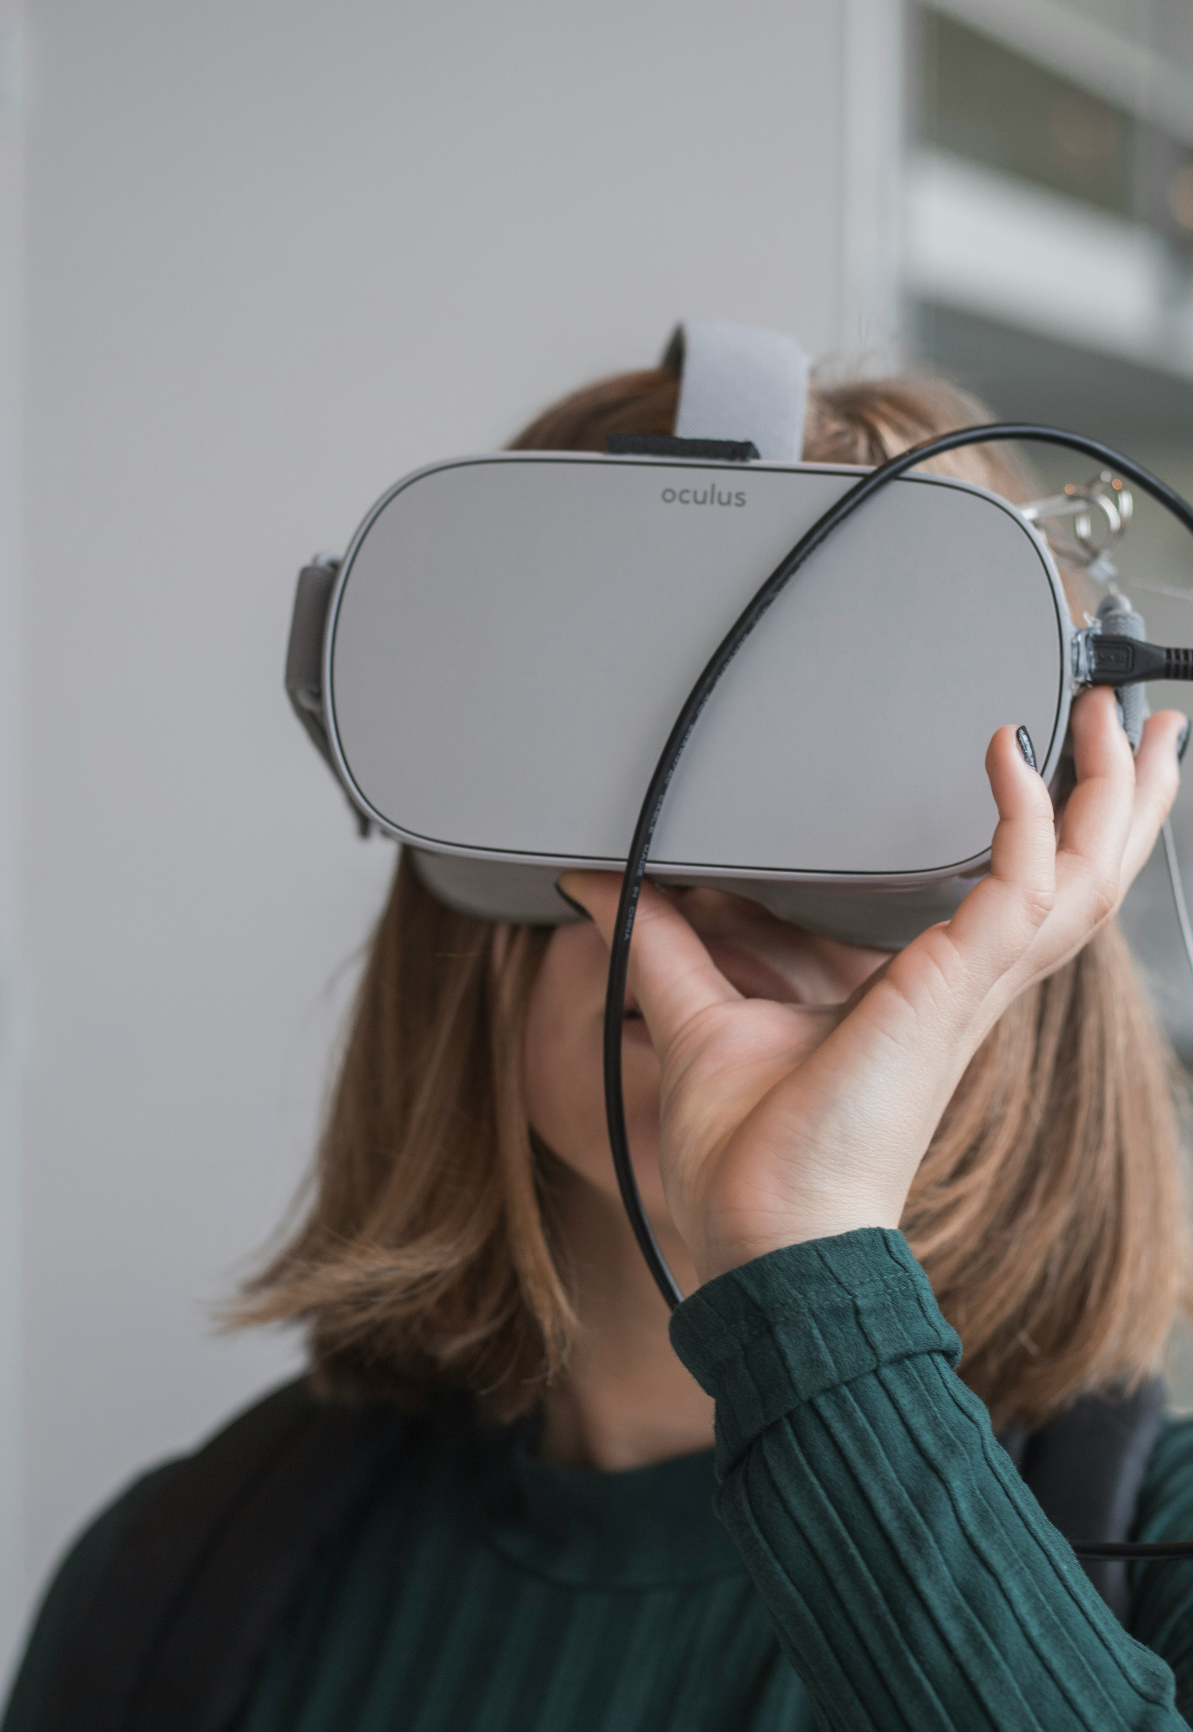
Development Process
Our neural network model can work with the latest smart or VR glasses. Famous company like Ray-Ban and Google already launched their smart glasses. These glasses are multifunctioning. Our model can be a module-like software and app installed in these smart glasses. Again, photo editing software like Adobe Photoshop can use the model to help the CVD people with more efficient editing opportunities.

Slide 8
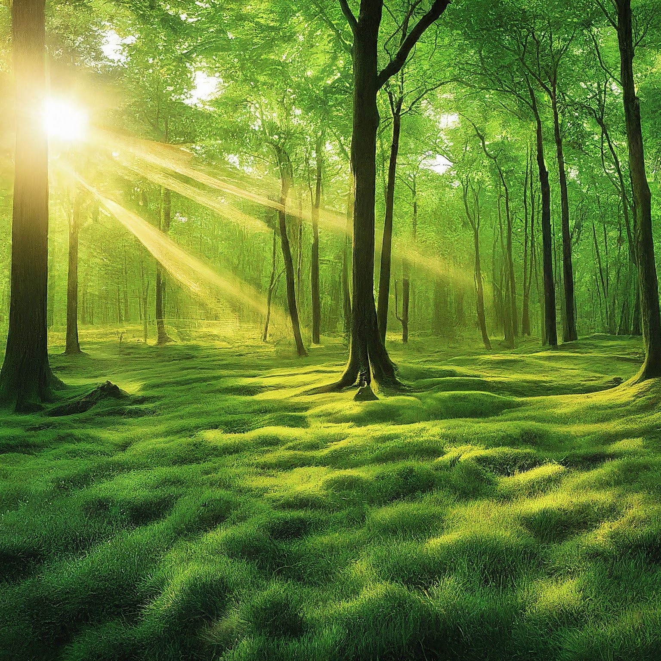
Environment Considerations & Sustainability
Promotion of Inclusivity and Social Equity: Develop systems to simulate, quantify, and compensate for CVD and promote inclusivity in technology. Participating in digital environments fosters social sustainability by reducing discrimination and promoting equal opportunities.
Minimization of Electronic Waste: Accommodating CVD through software solutions potentially reduces electronic waste generated from obsolete or replaced hardware, contributing to environmental sustainability.
Enhancement of Energy Efficiency: Providing a digital platform for addressing CVD promotes energy efficiency by encouraging the adoption of energy-saving software solutions over resource-intensive hardware alternatives.
Global Reach and Impact: Nurturing individuals with color vision deficiencies to better interact with digital content and technology contributes to global sustainability.
Advancement of Awareness and Education: Educating developers and users about the needs of CVD fosters a culture of inclusivity and sustainability in technology development.

Slide 9
Tools & Technologies
Software
Hardware
A deep learning framework, PyTorch, was needed to train and run the deep learning model.
Daltonization library was used for the custom dataset to train the deep learning model and generate color-deficient-friendly target images.
Other software tools, such as Python, NumPy, and Matplotlib, are also used for data preprocessing and further analysis.
IDE, like Visual Studio Code, was also used to write the code and run the notebook.
Image Quality metrics like MS-SSIM, and SSIM were used to find the structural similarity between the reconstruction and ground truth.
GPU is essential in training and running deep learning models, especially on large and complex image datasets.
A large amount of memory was also required, as large Autoencoder models often need to process large datasets of images.
A cloud computing platform like Google Colab or Kaggle provided the necessary hardware resources and scaled the computation to multiple GPUs.

Slide 10
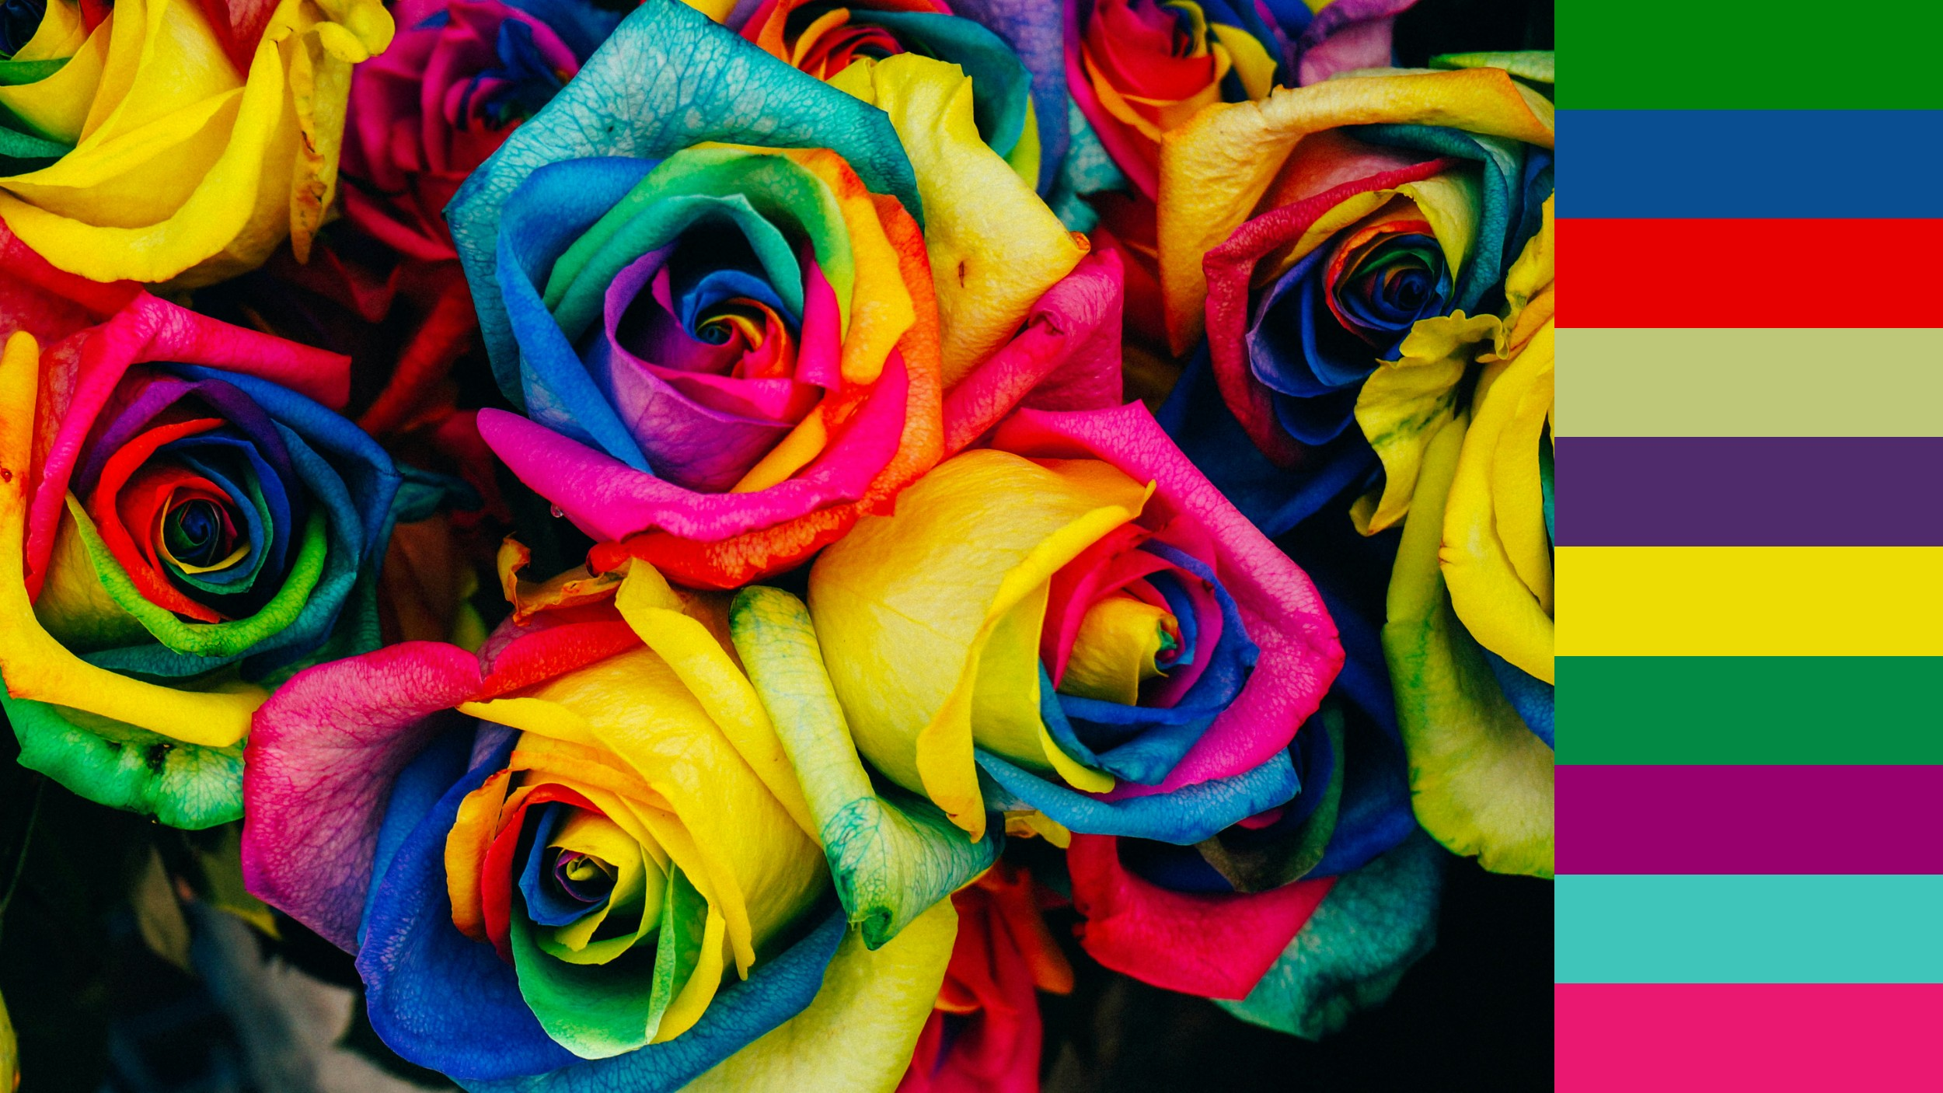
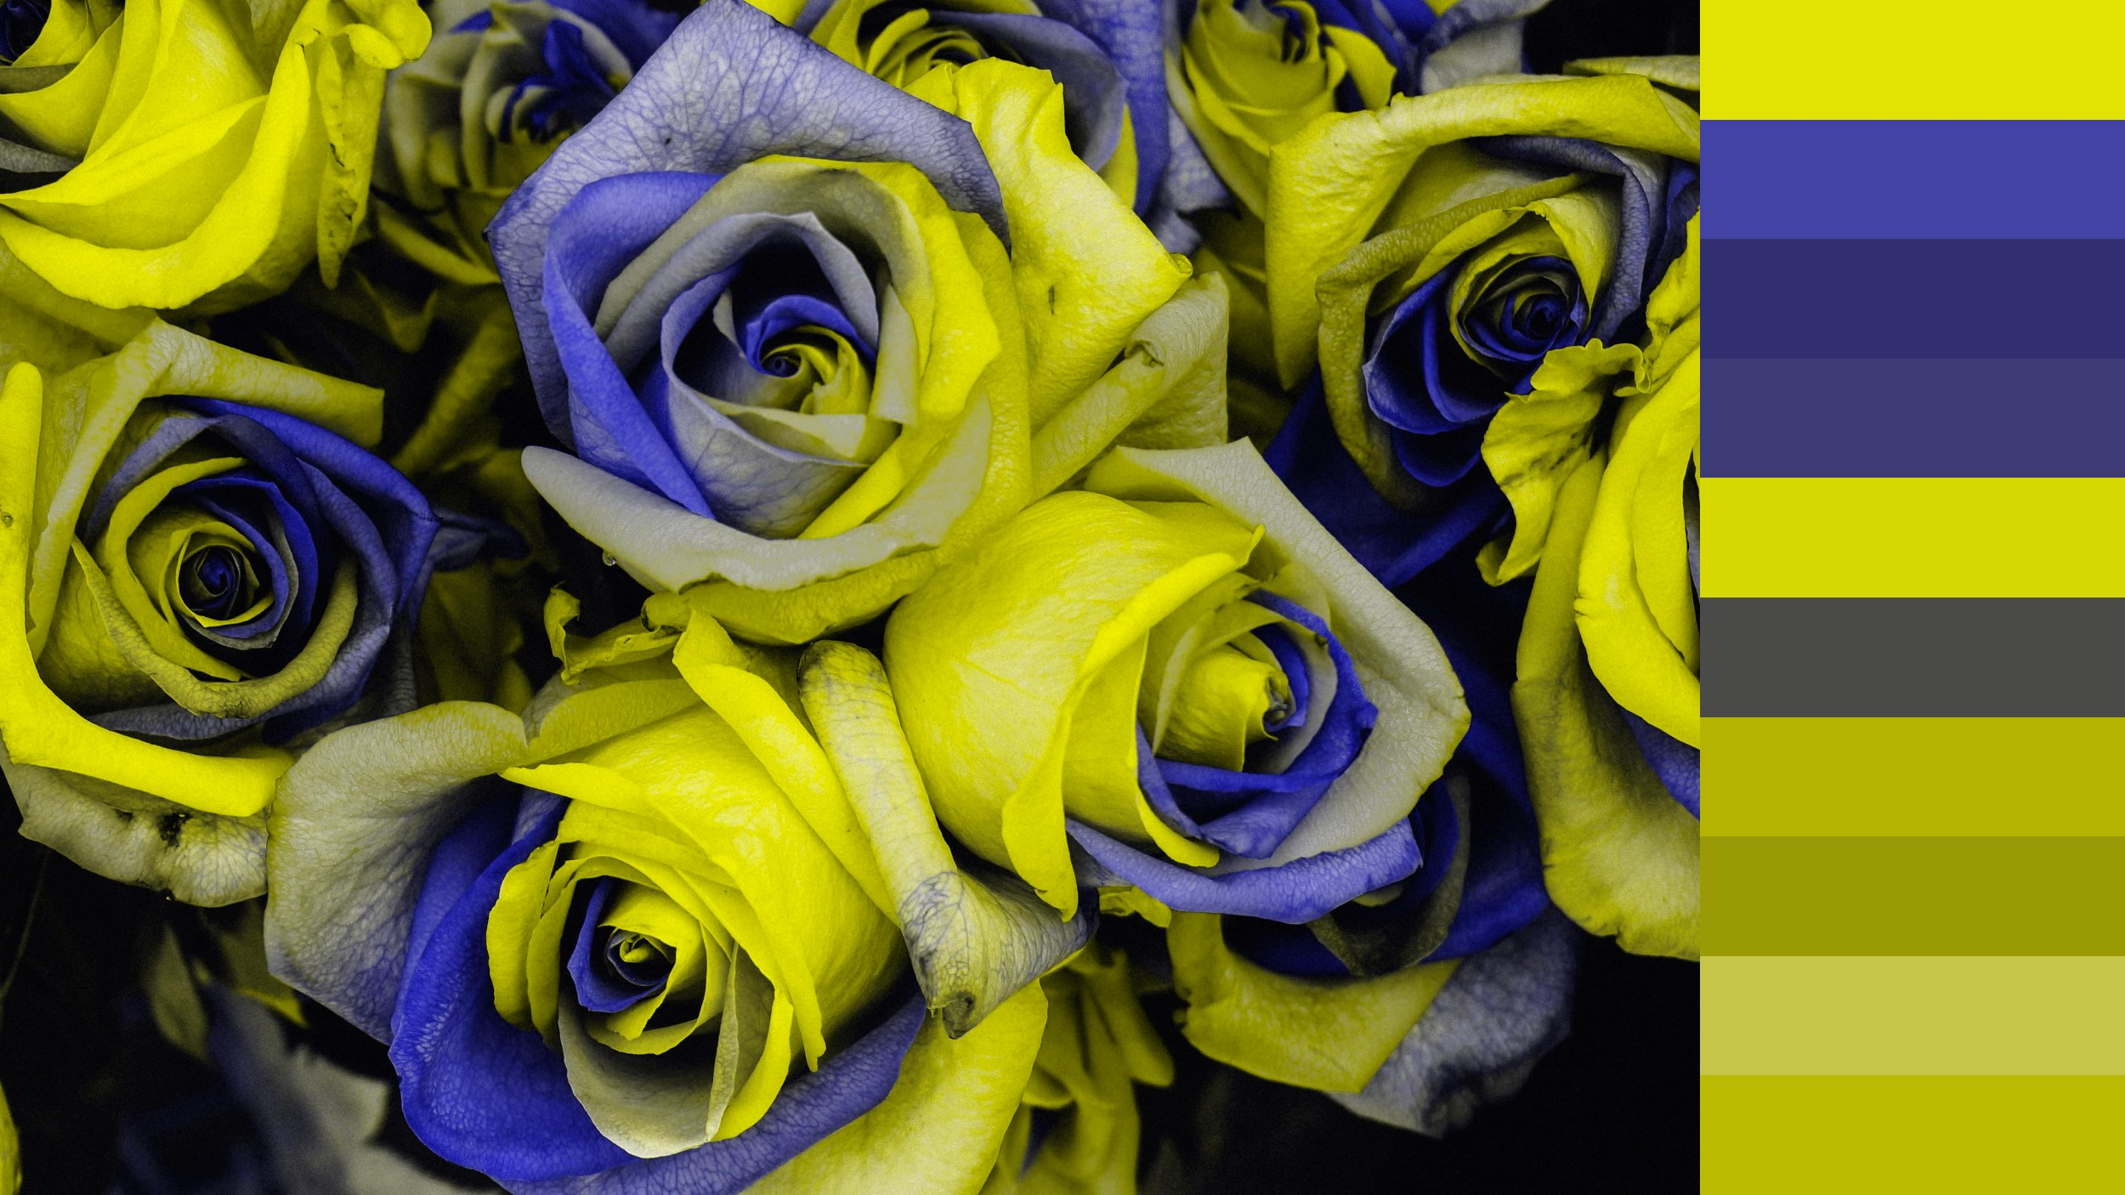
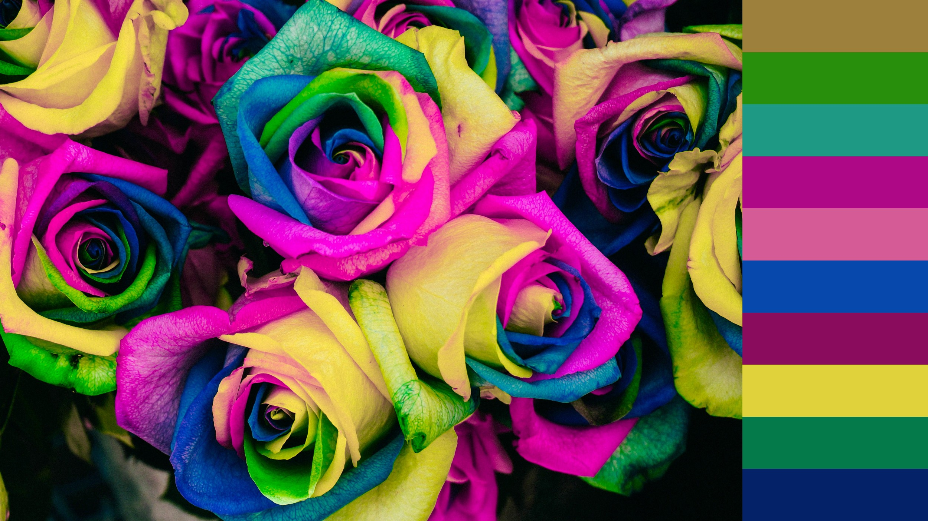
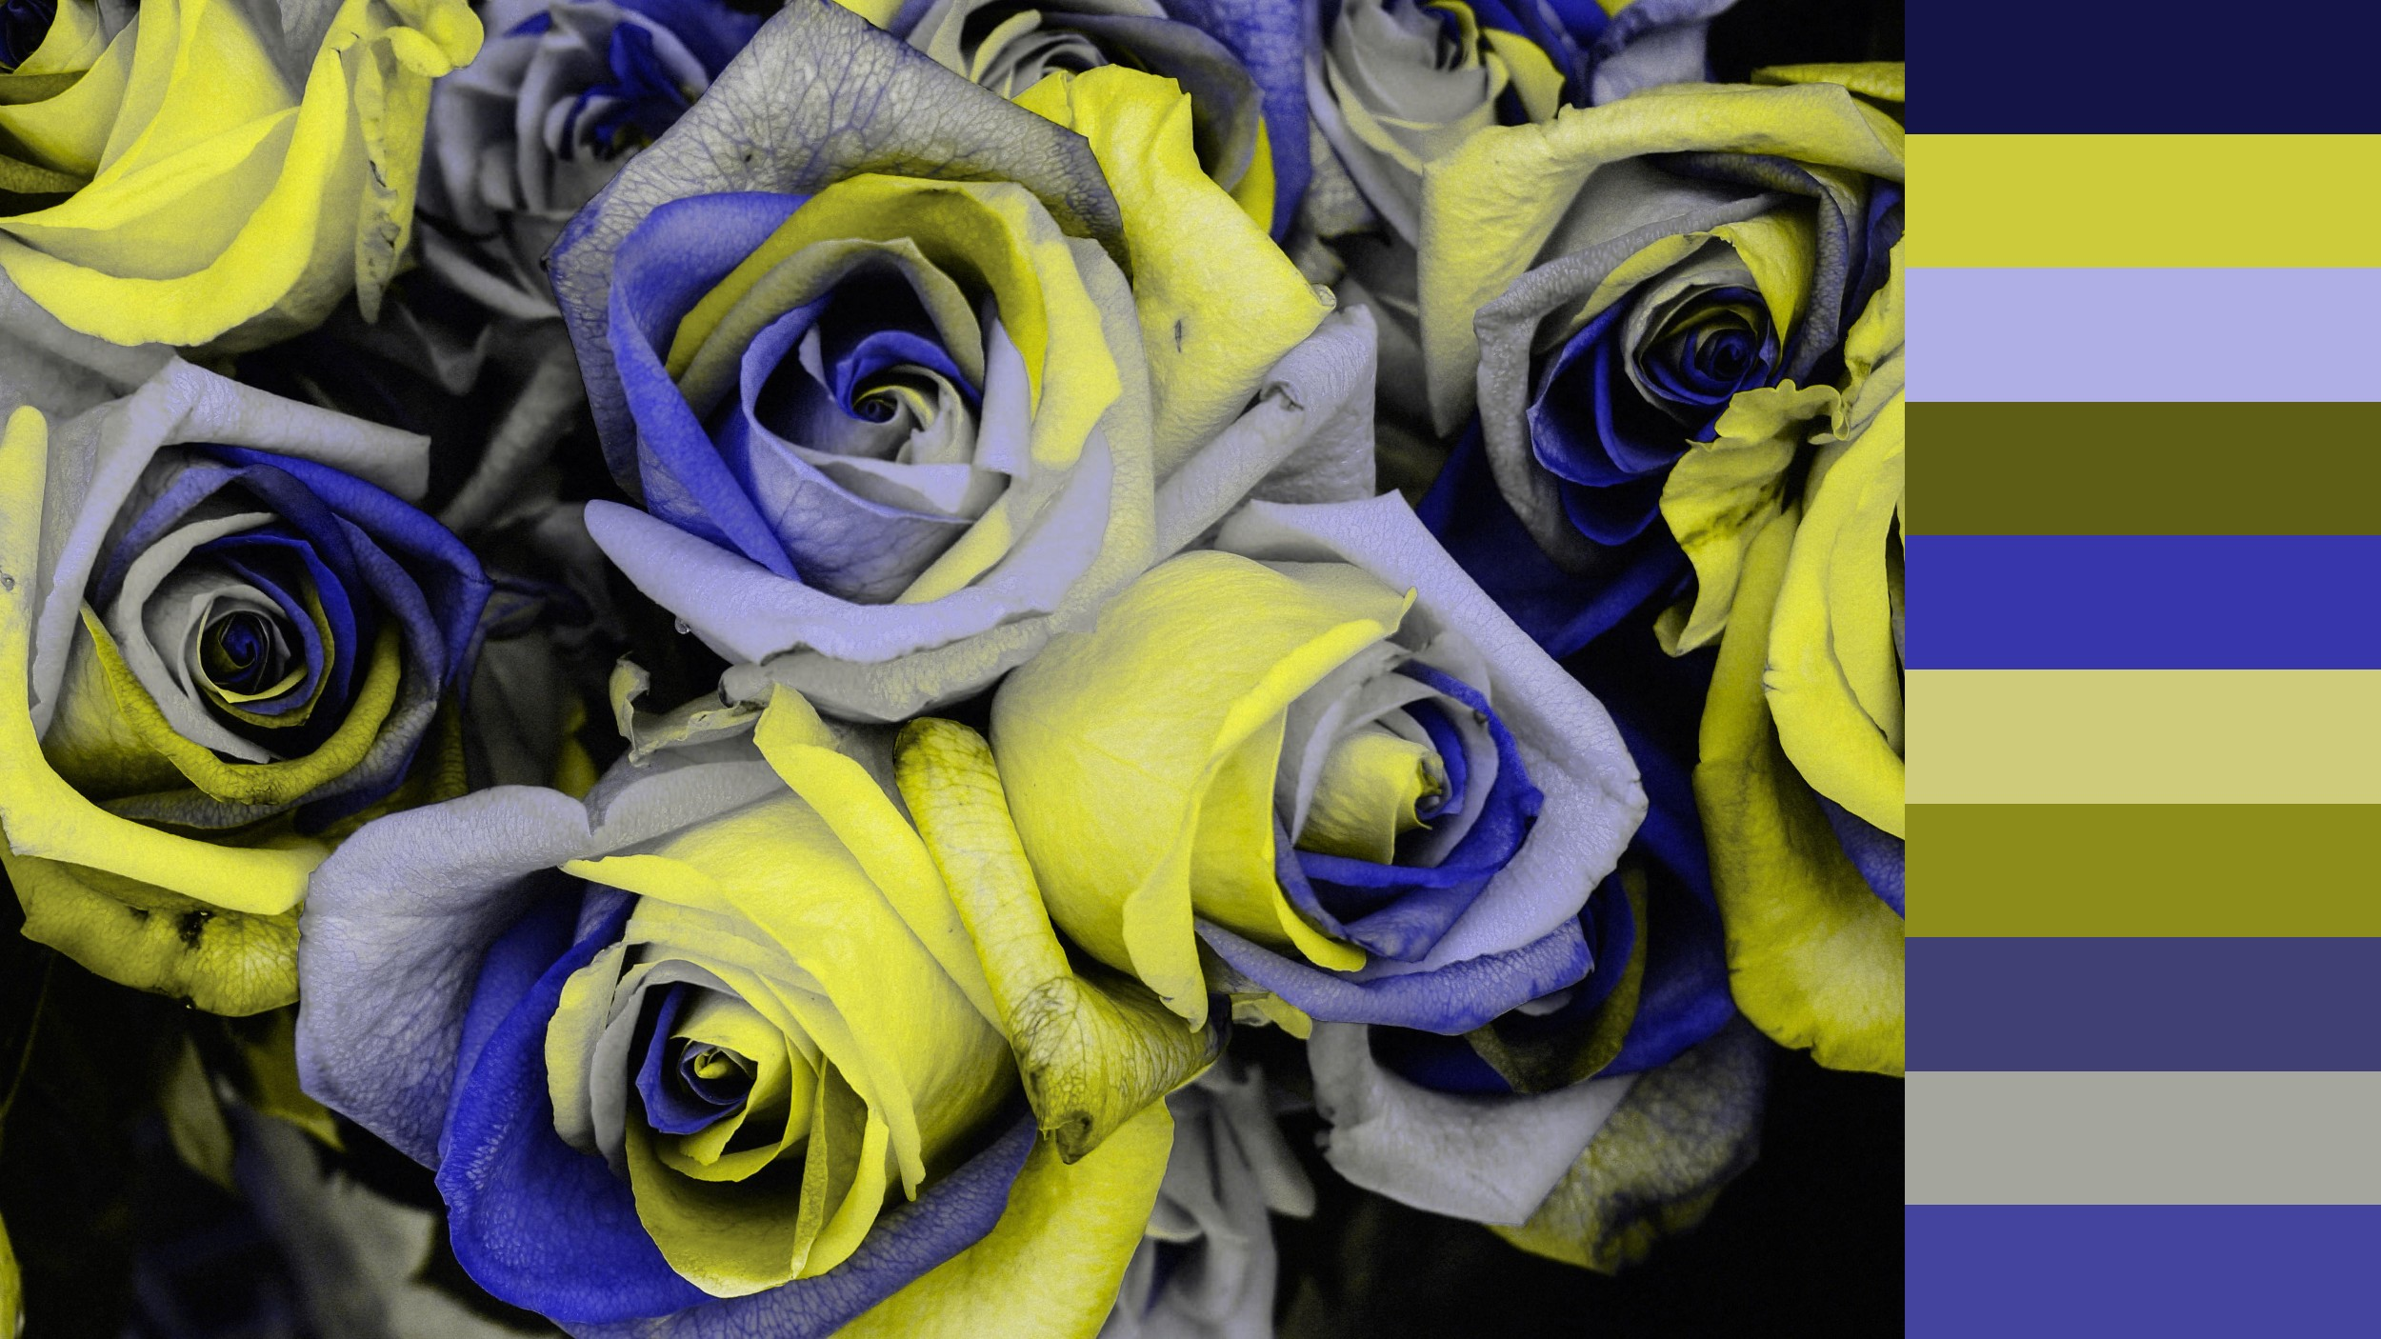
RESULTS (Visualized)
To a Deuteranope,the
flowers
would
look
like this →
Original Image with original colors / shades
The green and red colors and their related shades look the same
If we
do a simulation on top of the daltonization it will look like this →
Daltonization modifies the colors:
Now a Deuteranope can distinguish the flower’s colors so easily.

Slide 11
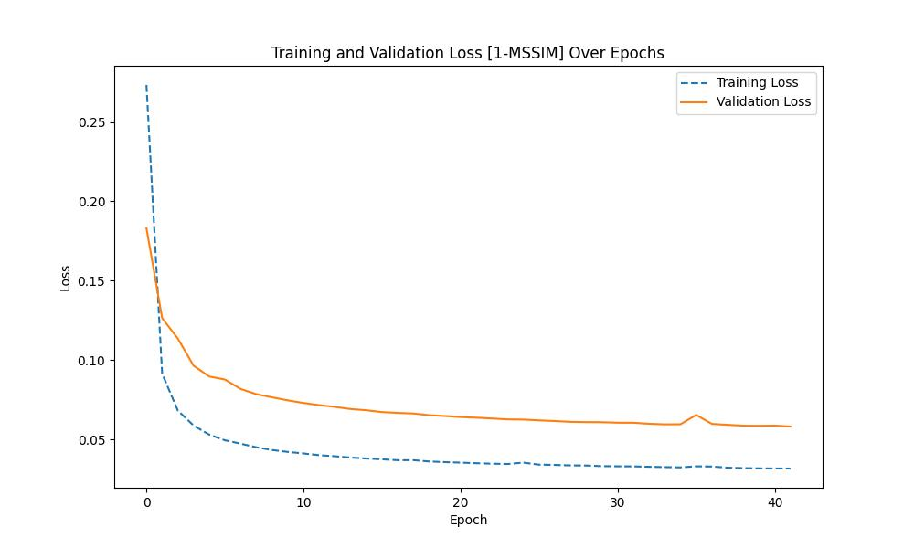
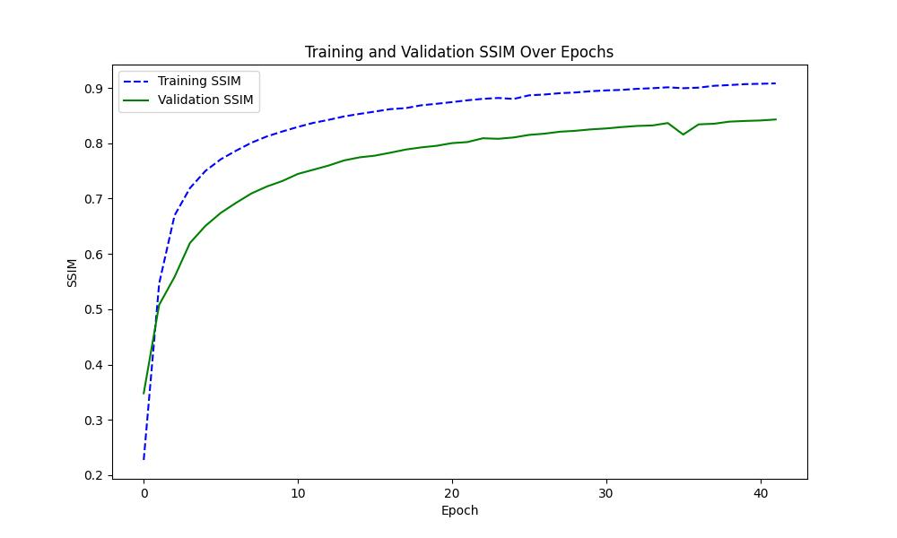
RESULTS (Curves)
Training Loss: 3.16%
Validation Loss: 5.81%
Training SSIM: 90.83%
Validation SSIM: 84.30%

